Slide 1
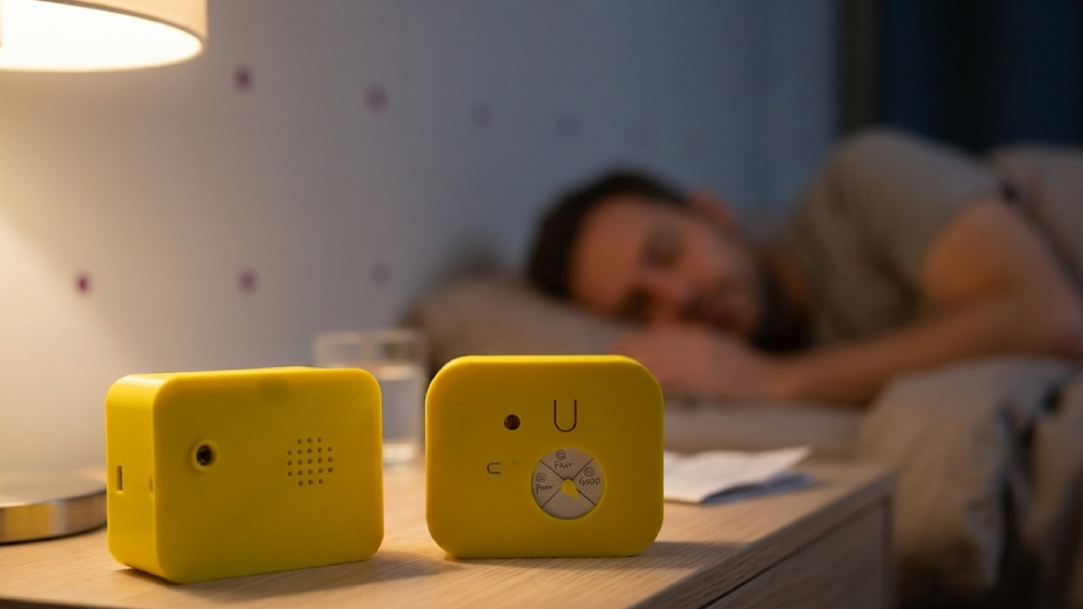
IOT SLEEP MONITORING SYSTEM
SnoreSense
A Snoring-Based Sleep Quality Indicator
GitHub repo: https://github.com/LukinaChen/TECHIN-514--Hardware-Software--Final-Project

Slide 2
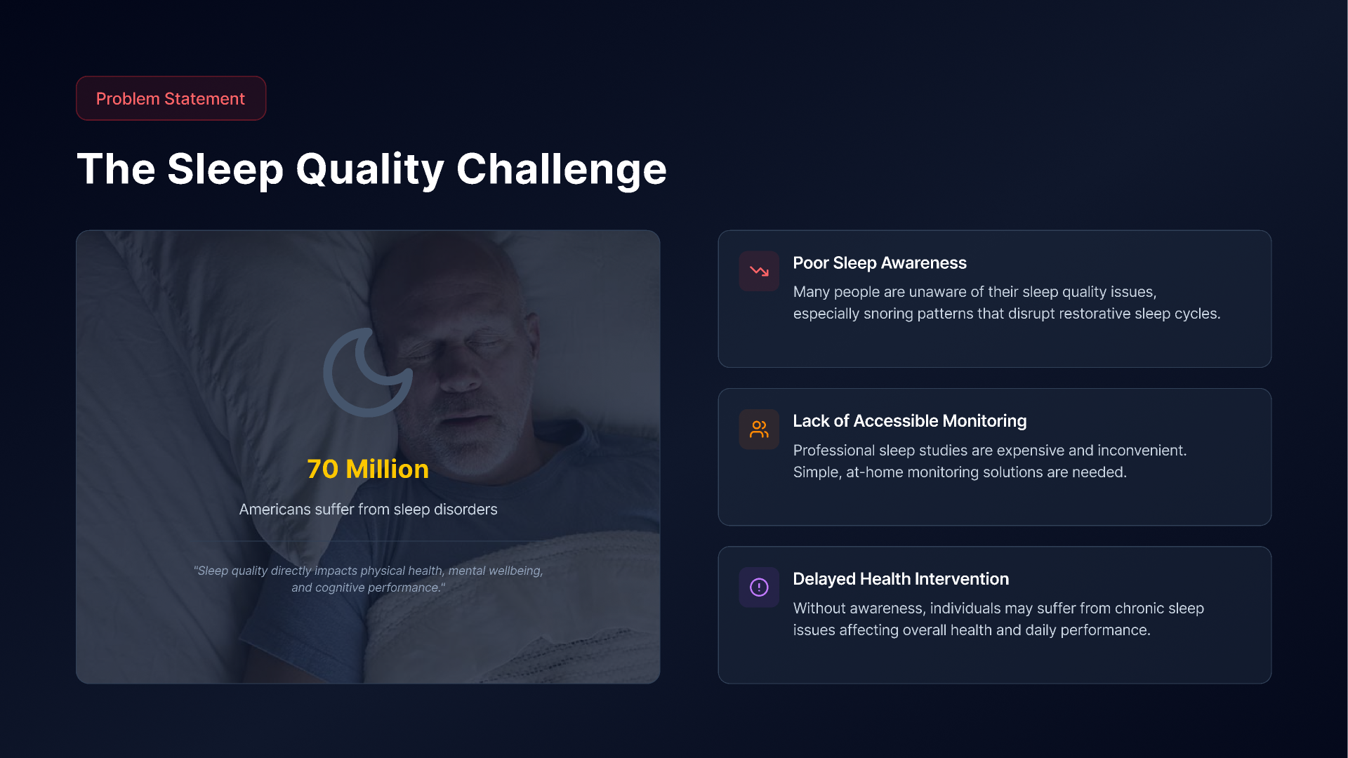

Slide 3
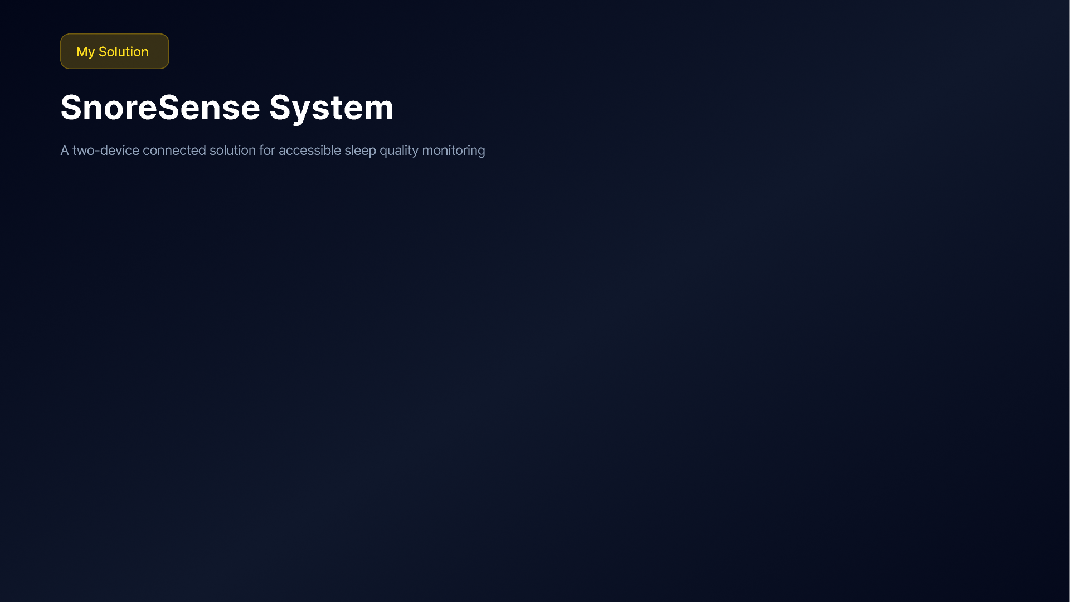
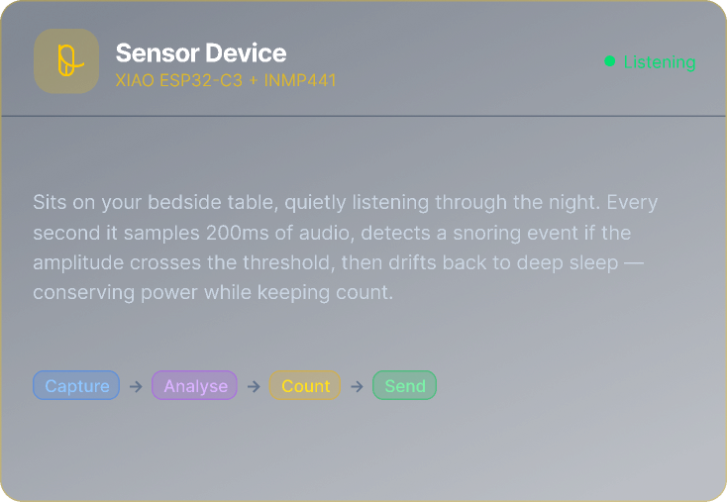
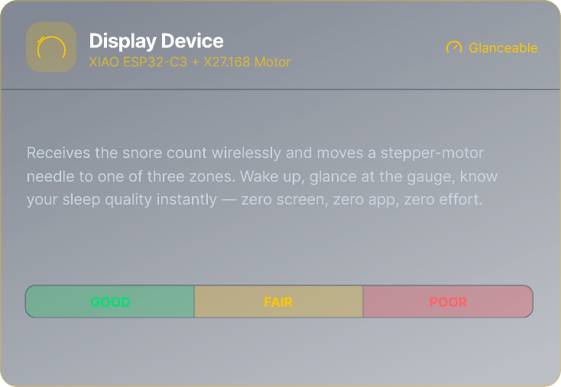
ESP-NOW
Wireless ESP-NOW
Ultra-Low Power
No App Required
Direct peer-to-peer, no router needed
Multi-night runtime on a single charge
Physical gauge — readable in seconds

Slide 4

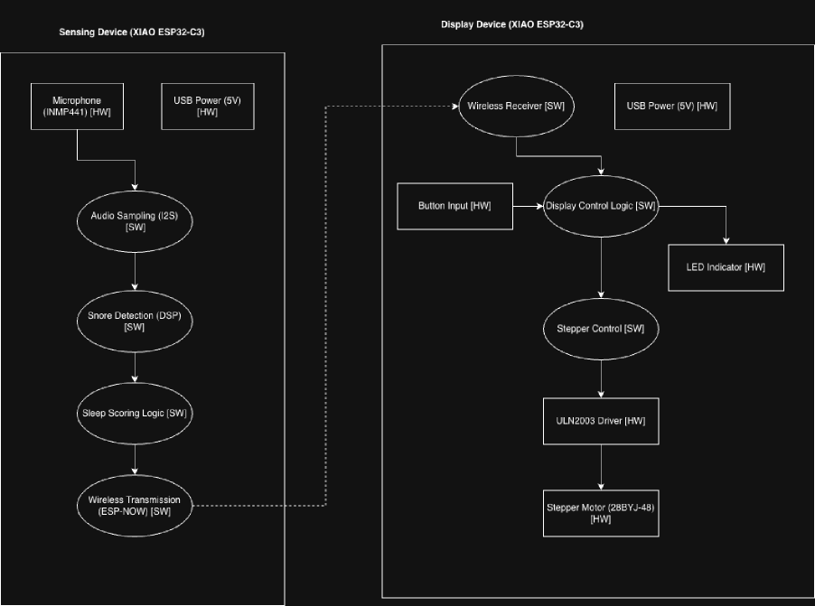
4 / 12

Slide 5
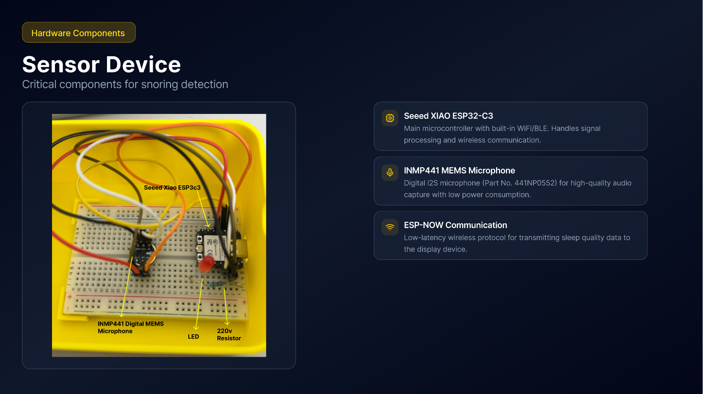
5 / 12

Slide 6
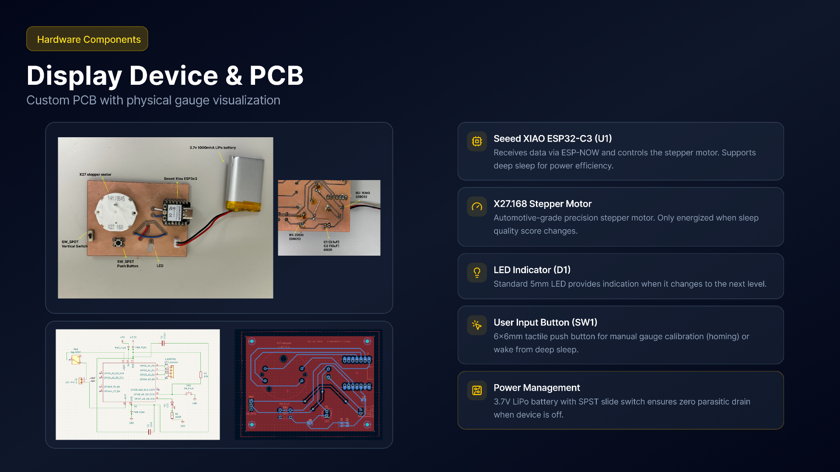
6 / 12

Slide 7
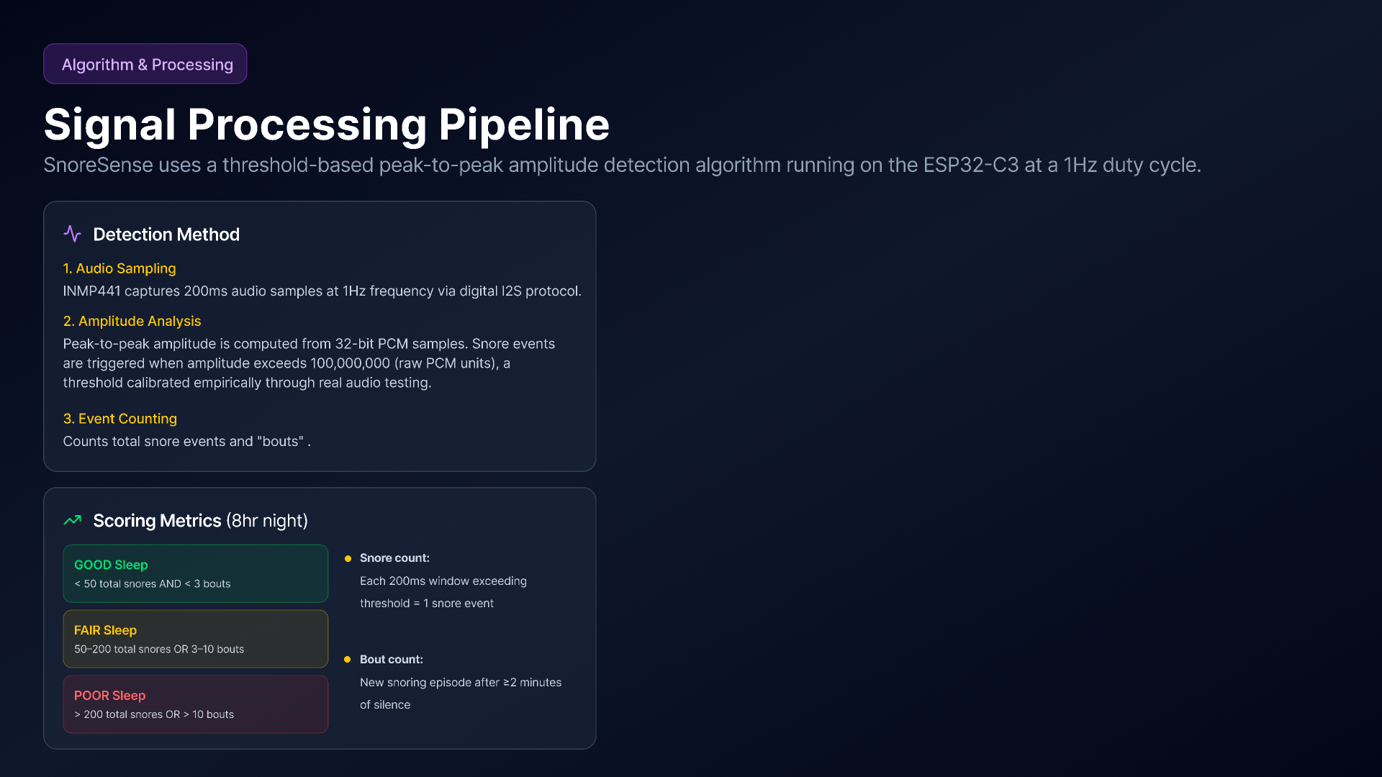
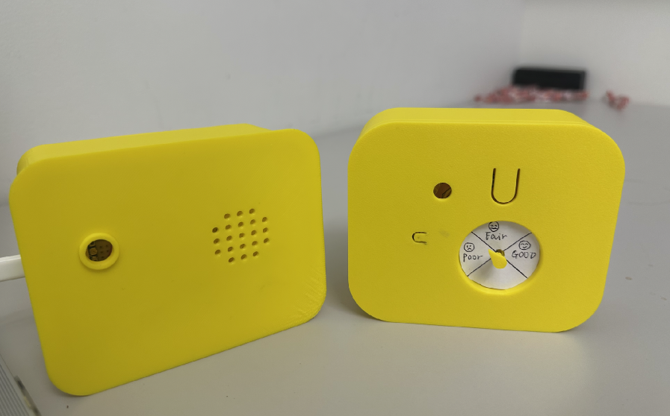
7 / 12

Slide 8
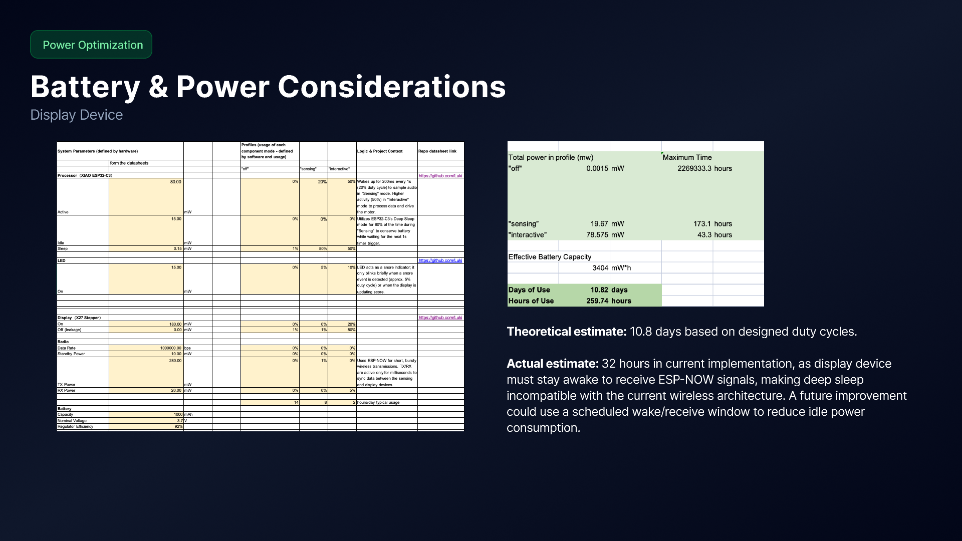
8 / 12

Slide 9

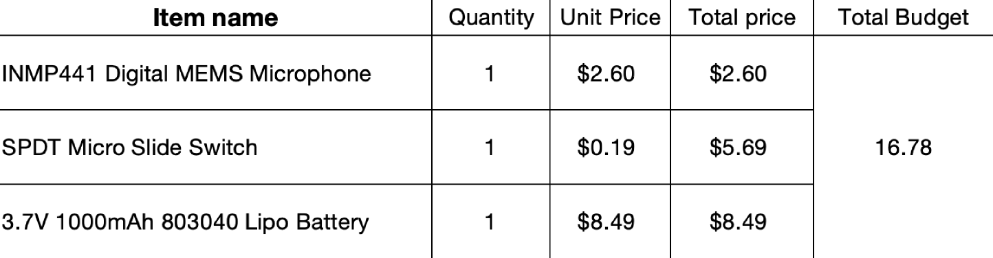
9 / 12

Slide 10
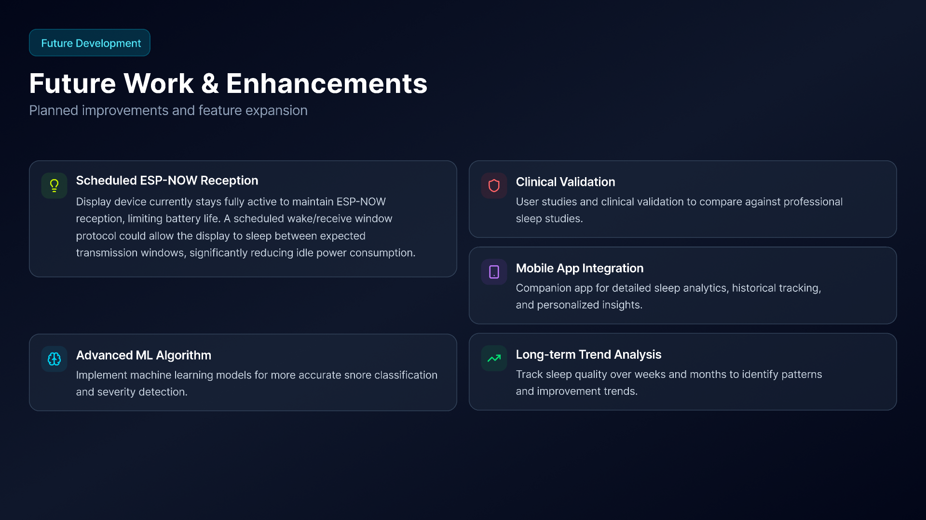
11 / 12

Slide 11
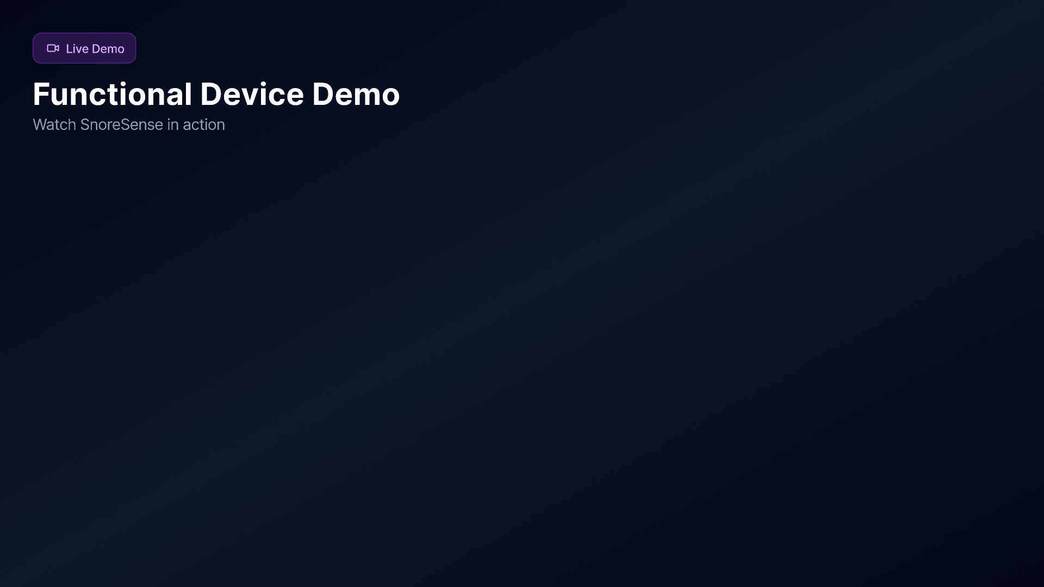

12 / 12

